Slide 1
BSN Steering Committee
October 2019

Slide 2
Agenda
HSA Workflow Discussion
Baptist Employee Health Plan Review
Program Reporting/Updates

Slide 3
Our Value-Based Program Solution
What it addresses
BSN’S value-based program addresses the rising costs and exposure to variability through its offer of:
Predictable, prospective bundled pricing for neurological care
Demonstration of proven high quality outcomes for health plan members
Delivery of cost-effective care guiding patients to the right care at the right place at the right time
3
7
Notes:
If you recall the BSN value prop set out to address these same area and rising costs. There was an interesting article in Modern Healthcare recently which indicates employer health costs are expected to rise by 6.5% in 20202 and muscoskeletal is one of the top drivers
What we want to go through today are some of the proof points the BSN COE offering to other employers in the Memphis and national arena

Slide 4
Employer
Baptist Employee Health Plan Analysis

Slide 5
Key Findings
October 2018-August 2019 analysis
82% of patients who received an evaluation required no further intervention or went on to conservative care treatment
Program utilization of surgical intervention in the inpatient is 90% below market utilization while utilization of evaluative services to identify appropriate care is 40% above
The BSN COE is drawing people from across the tri-state area; suggesting ability to market program broadly

Slide 6
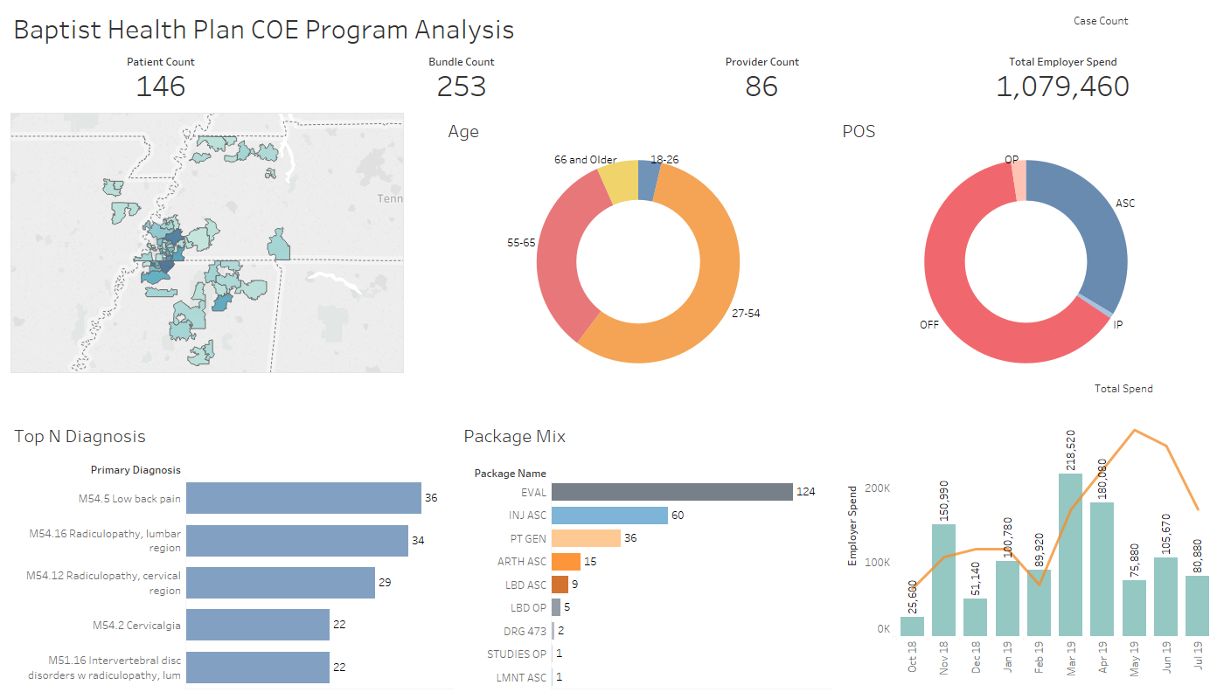
Baptist Health Plan Demographics
Key Findings
Services are following a conservative care pathway with minimal surgical intervention
Patients are traveling from across the tri-state area, up to 2:30 hours from Union City and other areas
Main diagnostic treatment encompasses low back pain and radiculopathy or “pinched nerve” of the lumbar and cervical regions
Notes:
The first area we look at is clinical excellence and utilization. I.E are patients using the program, and when they are how are the being treated?
Cervicalgia is a neck pain injury
Lower back is lumbar---between chest and sacrum

Slide 7
Geographic Utilization
Patients are traveling from across the tri-state are to receive services
60% are from Tennessee with 38% from Mississippi and 2% from Arkansas
Mississippi
Tennessee
Arkansas
Patient Zip Code | Patient Count
38632 | 8
38654 | 8
38671 | 8
38637 | 6
38652 | 6
38603 | 3
38651 | 3
38672 | 3
38965 | 3
38655 | 2
38663 | 2
38668 | 2
38610 | 1
38659 | 1
38683 | 1
38829 | 1
38878 | 1
38916 | 1
Patient Zip Code | Patient Count
38017 | 8
38002 | 6
38125 | 6
38018 | 4
38053 | 4
38117 | 4
38138 | 4
38139 | 4
38109 | 3
38119 | 3
38133 | 3
38016 | 2
38058 | 2
38104 | 2
38128 | 2
38134 | 2
38135 | 2
38141 | 2
Patient Zip Code | Patient Count
38004 | 1
38011 | 1
38028 | 1
38068 | 1
38075 | 1
38103 | 1
38107 | 1
38120 | 1
38122 | 1
38183 | 1
38225 | 1
38240 | 1
38242 | 1
38255 | 1
38257 | 1
38261 | 1
38317 | 1
38372 | 1
Patient Zip Code | Patient Count
72472 | 1
72417 | 1
72401 | 1
72354 | 1
38118 | 1
38060 | 1
Notes:
Union city and vardem were the highest ones
Collierville, Arlington, and Memphis
Missiissppi- hernando the nolive branch and Southaven

Slide 8
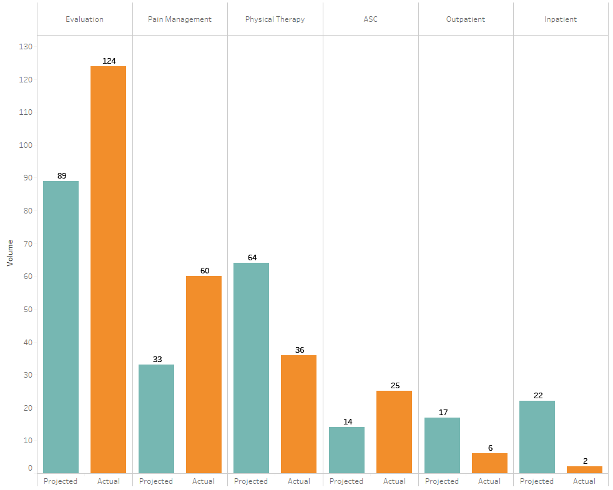
Program Utilization Comparison
Key Findings
Market
Expected program utilization is within market range while the bundle mix and POS is favorable to employers
BSN COE uses 90% lower inpatient, services compared to the TN market utilization rates
Significant employer cost savings associated with avoidance of more expensive treatment options
Opportunity to review PT utilization over ASC
*Projected utilization based on Truven Market Data for 1 year

Slide 9
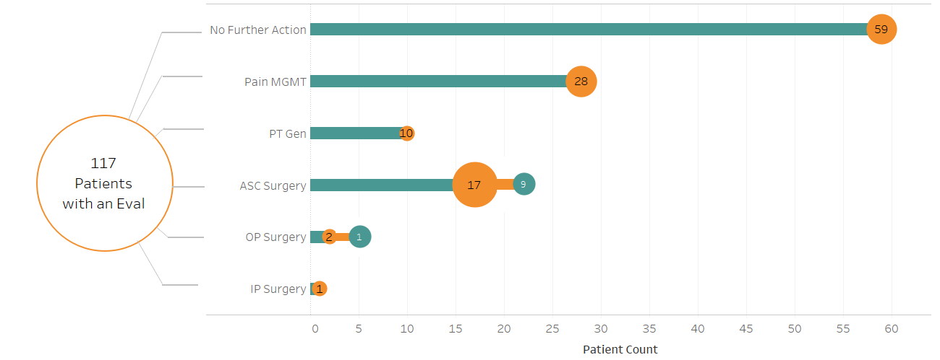
Evaluation pathway
Providing the Right Care at the Right Place at the Right Time
50% of patients evaluated received no further intervention while 32% received conservative care treatment following an evaluation
Only 16% of patients evaluated progressed to an outpatient surgical setting and less than 1% were recommended for inpatient surgery
Notes:
117 patients

Slide 10
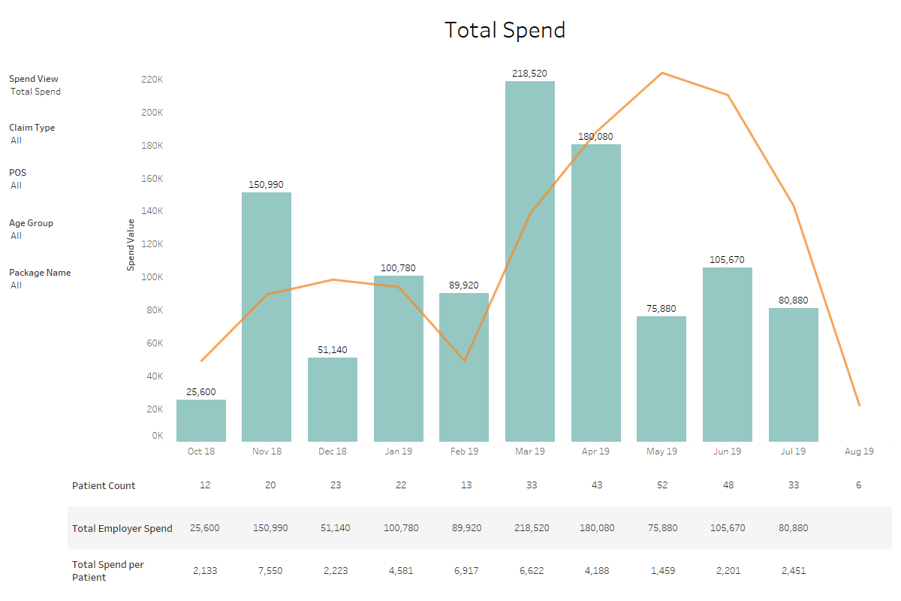
Total Spend by DOS
Key Findings
Highest patient count reflected one of the lowest spend months due to evaluation and conservative care treatment options
Spikes indicate outpatient surgical intervention and inpatient case volumes

Slide 11
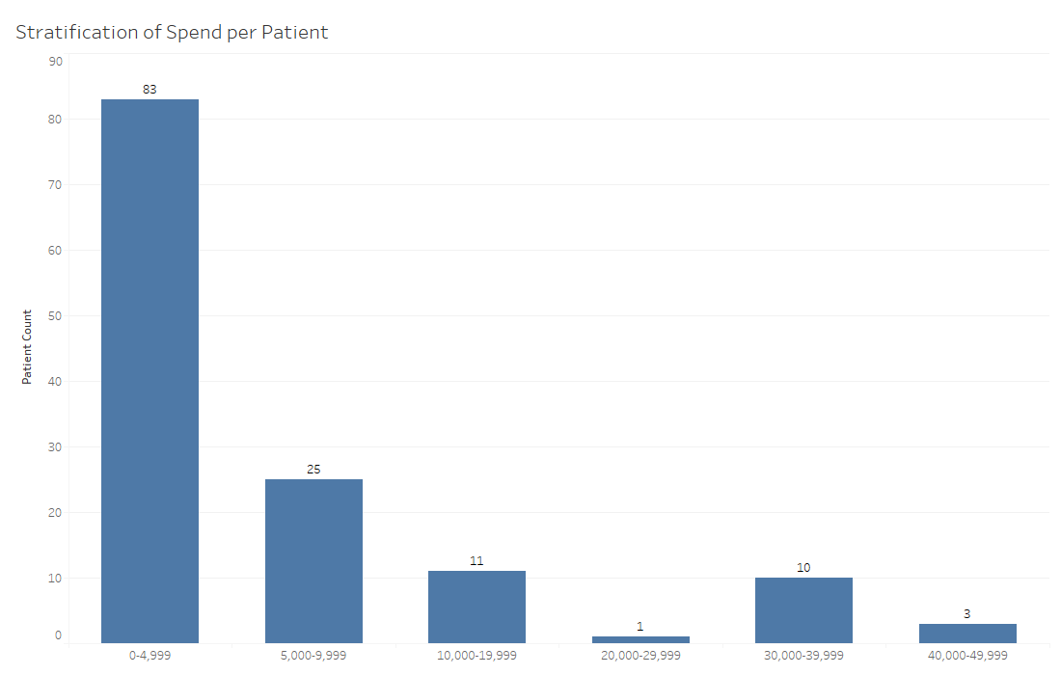
Patient Spend Stratification
Key Findings
Stratification by patient spend
Largest portion of patient spend is in the more conservative treatment pathways
62% of patient fall into the $0-$4,999 spend category

Slide 12
BSN far exceeds national quality measures for Return to Work
Brain and Spine Network is the largest site Contributor to QOD
The QOD serves as a continuous national registry for the most common neurological, neurovascular and spine procedures. Top healthcare organizations use its infrastructure to define, measure and continuously promote quality of care, leading to improved patient outcomes. *
source: “Statistics and Outcomes Report Lumbar.” Quality Outcomes Database, March 2019

Slide 13
BSN far exceeds national quality measures for Back Pain
Brain and Spine Network is the largest site Contributor to QOD
The QOD serves as a continuous national registry for the most common neurological, neurovascular and spine procedures. Top healthcare organizations use its infrastructure to define, measure and continuously promote quality of care, leading to improved patient outcomes. *
Patients rate Back Pain on a 0-10 scale with 0 indicating no pain and 10 indicating worst pain
source: “Statistics and Outcomes Report Lumbar.” Quality Outcomes Database, March 2019
Representative program data

